Slide 1


Solving Medical Device Development Headaches
A closer look at Testing and Development Documentation
Neil Langmead, Technical Consultant, Emenda
Anders Emmerich, CEO, Aligned AG
March 4th 2014

Slide 2
Agenda – Part 1
08:30 – 09:00 Welcome and Coffee
09:00 – 09:45 FDA Software Development: two bottlenecks and current challenges
Achieving FDA Guidelines on Software Architecture
Achieving FDA Guidelines on Unit and Integration Testing
New Guidelines from the FDA on Software Security
09:45-10:30 Technical Demonstration of Total Testing Platform
Multi dimensional Software Analysis, Advanced Defect Detection
FDA-tuned Reporting for Architecture, Bugs, Security
Analysing Software Architecture and Dependencies

Slide 3
Agenda – Part 2
10:45 – 11:30 Design History File Bad Practices
How Not to Manage your Design History File
Typical Examples from Real World Cases
11:30 – 12:30 Automated Design History File Management
Saving Time Through Automation and Control
Improving Quality with Continuous Consisency Analysis
Single Click Document Generation
12:15- 12:30 Buffet lunch, discussions, further demonstrations as required

Slide 4

Bottlenecks & Challenges
Testing and Documentation are both known to be problematic, difficult to automate, challenging problems in FDA projects, and more generally in all safety critical software projects.
This short seminar looks at possible solutions to the two above problems.
We will focus only on technical solutions to real world problems in this presentation and demonstration

Slide 5
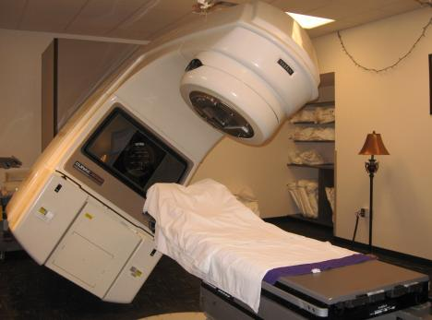
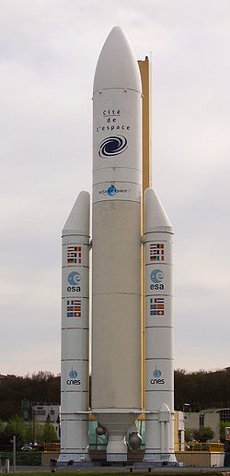
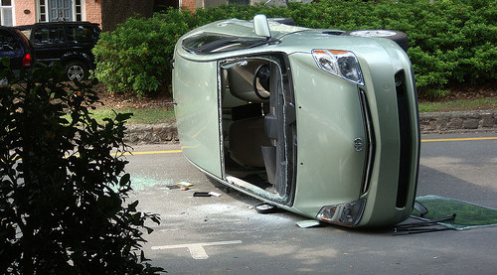
Why test? In Software generally…
Therac-25 Radiation Therapy Machine
Death of 3 patients due to massive overdose of radiation
Toyota Prius
100K+ vehicle recalls
Ariane 5 Flight 501
Loss of $370M spacecraft
Notes:
Embedded software development can be a risky business.
Not least because of the actual safety implications of some of the systems that we are producing.
Therac-25 Radiation Therapy Machine
Event: Involved in at least 6 accidents where patients were given massive overdoses of radiation (100X the intended dose)
Impact: Radiation burns, symptoms of radiation poisoning, and the death of 3 patients
Causes: Software design that made it impossible to test in an automated fashion. Main software flaw was determined to be a race condition
Note: Code was written in assembly language.
Toyota Recalls
In 2005, Toyota announced a recall of 160,000 of its Prius hybrid vehicles following reports of vehicle warning lights illuminating for no reason, and cars' gasoline engines stalling unexpectedly. But unlike the large-scale auto recalls of years past, the root of the Prius issue wasn't a hardware problem -- it was a programming error in the smart car's embedded code.
In 2010, software bug causes issues with the Anti-Lock Braking system resulted in recall of 100K+ cars.
Ariane 5 Flight 501
Event: Rocket veered off its flight path 37 seconds after launch. Destroyed by its automated self-destruct system.
Cost: Loss of 4 “Cluster mission” spacecraft worth over $370M
Cause: One of the most infamous software bugs in history. Inadequate protection from integer overflow
Now I know NSN are not in the business of producing rockets, or radiation machines, or even uncontrollable automotive vehicles, but I’m sure that some of your systems have a safety or mission-critical element.

Slide 6
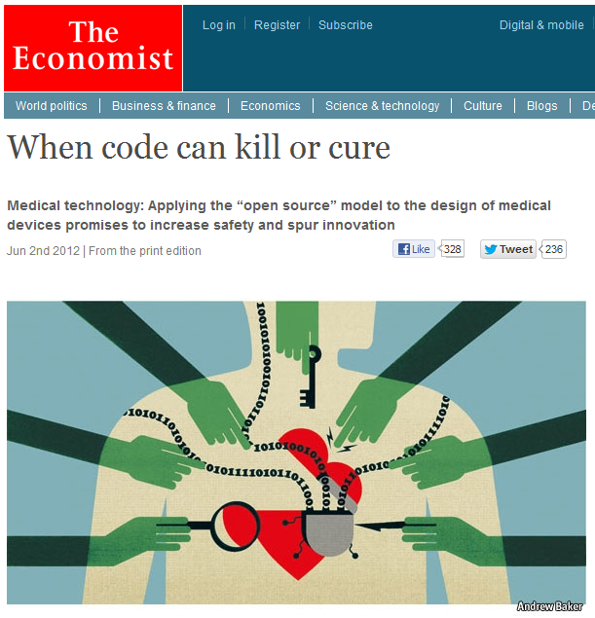
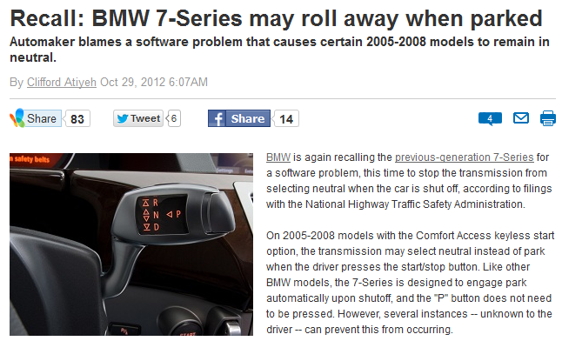
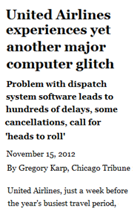

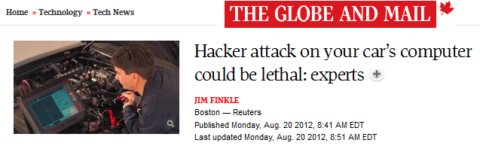
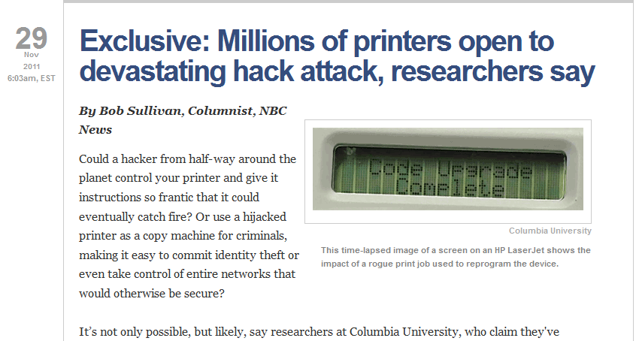
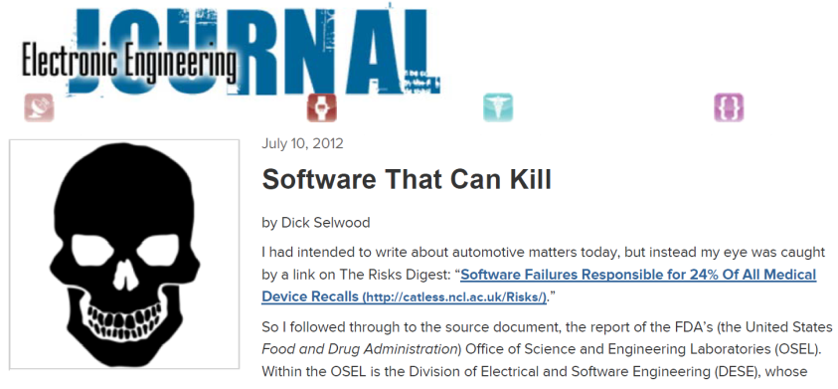
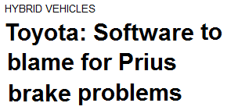
Why else?
Notes:
The potential for risk and failures themselves are well documented. If your software fails, people are going to hear about it.
When I was growing up, 15-20 years ago, if telephone stopped working for a day, nobody seemed to worry too much. These days, if the internet connection even goes down for a matter of minutes in my house, my children are all over me wanting to know when it will be fixed.
And with social media, breeding conditions for brand trashing viral outbreaks are about as perfect as anyone could ever have imagined. Think RIM and the unfortunate incidents with their UK server issues and the resulting message blackouts.

Slide 7
Medical Device Software Testing Guidelines
Notes:
First a little bit on who we are…

Slide 8
Functional Safety Standards Overview
DO-178b/c for aviation software
IEC 61508 for industry and more…
IEC 60880 for nuclear power
EN 50128 / 50129 for railway applications (CENELEC)
ISO 26262 for automotive software
IEC 62304 / FDA for medical device software

Slide 9
What all standards have in common
Define some rules that can be checked. For example:
  McCabe Cyclomatic Complexity < 10
  Max nesting level < 4
  No GOTO statements
  All global variables prefixed with glb_
  No dead code
  No unused variables
  etc
Justify why these are sufficient
Generate evidence that your developments meet these rules

Slide 10
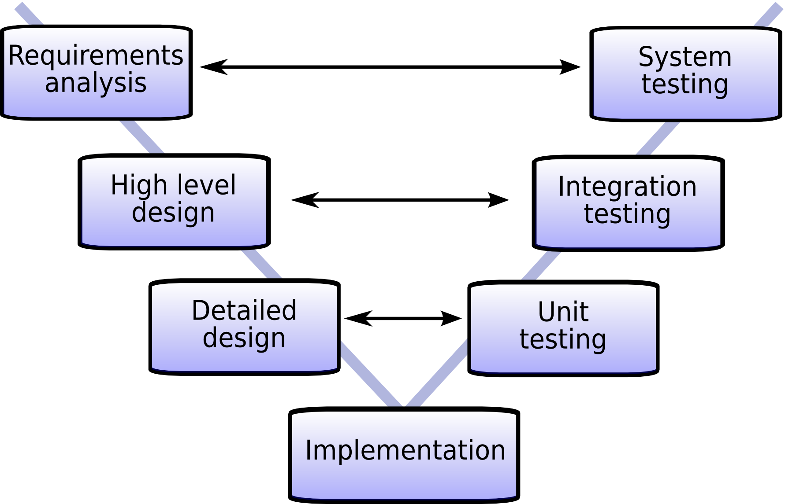
What’s in the FDA Guidelines?

Slide 11
Also applies for Iterative/Agile
Testing
Development
Deployment
Design

Slide 12
IEC 62304 - Software Testing Statements
“Appropriate consideration of software architecture (e.g., modular structure) during design can reduce the magnitude of future validation efforts when software changes are needed. “
“static analyses provide a very effective means to detect errors before execution of the code. They allow for examination of each error in isolation and can also help in focusing later dynamic testing of the software“
“Structural testing is accomplished primarily with unit (module) level testing, but can be extended to other levels of software testing.”

Slide 13

MISRA standards in FDA projects
Source Code Analysis (SCA) referenced as a technique in FDA Guidelines
MISRA is a Coding standard, not functional safety standard
  MISRA C 2004
  MISRA C++ 2008
  MISRA C 3 / 2012
Prevalent in the automotive sector but also now being adopted by many medical companies as a standard (including two well known ones in Switzerland…)
The MISRA approach is to write safer software from the beginning be using a very restrictive subset of the language
  Example: MISRA C 2004: Rule 20.4 (required): Dynamic heap memory allocation shall not be used.
  C library dynamic memory – surely better the devil you know?
  What if we can check for correct usage?

Slide 14
What is Static Code Analysis?
Static Analysis
Static Code Analysis (SCA)
Code Format
Refactoring
Code Standards
Defect Finding
Code Metrics
Security Checks
IP Compliance
Architecture
Notes:
Static Analysis, or Static Program Analysis, is the analysis of computer software that is performed without actually executing programs (analysis performed on executing programs is known as dynamic analysis).
Static Code Analysis (abbreviated SCA) is a subset of Static Analysis applicable when the analysis is specifically performed on the source code rather than object code/byte code.
It’s a very broad term, however. Static Analysis data is obtained without running the program, yes, but what to what end? And what data?
Types and uses of static analysis technology include:
Code format – code style checking / beautification: making sure that the indentations and formatting is clear and inline with guidelines
Code standards – code compliance / coding rules: making sure that code constructs are compliant with coding standards (e.g. MISRA / CWE)
Code metrics – complexity metrics / issue metrics: checking that various academic metrics and values (e.g. McCabe, LOC, Churn, Coupling)
IP Compliance – license checking and compliance: ensuring that uses of external 3rd-party software packages are correctly licensed, etc
Architecture – architectural analysis / DSMs: visualisation of the system architecture and dependency structure information
Security Checks – code/program security analysis: checking for potential security holes either in the source code or object code
Defect Finding – code defect analysis / bug finding: checking for programming errors and, quality and reliability abnormalities
Refactoring – code refactoring / cleaning: trying to improve the maintainability of the software through the removal of redundancies, etc.
Klocwork provides support for all of these different types of Static Analysis, apart from IP Compliance and Code Format/style checking.

Slide 15

At first there was Lint…
The term was derived from the name of the undesirable bits of fibre and fluff found in sheep's wool.
Lint, a C program checker. Stephen C. Johnson, Bell Laboratories,
December 1977.

Slide 16
Evolution of Source Code Analysis
1970s
2000s
Today
Basic checking for suspicious & non-portable constructs
Whole program inter-procedural control/data-flow analysis
Partial & incremental whole program analysis ‘on-the-fly’
Notes:
SCA tools have evolved considerably over the past 25 years, though much of this evolution occurred following the arrival of engines capable of the whole-program, inter-procedural, control and data-flow analysis, like Klocwork, in the early 2000s.

Slide 17
SCA Evolution: Structural code analysis
Structural code analysis
Whole program analysis
Smart on-the-fly analysis
At first there was Lint…
  And then a few others
What were they doing?
  Analysis of the compiler Abstract Syntax Tree (AST)
  On a translation-unit basis
  Looking for “suspicious and non-portable constructs” (likely to be bugs)
Intended as a developer’s tool
  Intended to “just give better compiler errors to the developer”
  Quick
  Easy
  Noisy

Slide 18

Structural defects
Simple coding mistakes…
Think:
  Assignments in conditions
  Suspicious semi-colons
  Variables uninitialized on declaration
Would probably be picked up with code reviews but quicker and more certain with a static code analysis platform

Slide 19

Inter-procedural control/data-flow defects
Often not local to one particular module
Not easy to spot with the human eye
  Not general found by code review
  Traditionally found with dynamic testing
Real bugs, not just typing errors
  Buffer overflows (code injection)
  Memory leaks, integer taint (DoS)
  Uninitialized data usage (data injection)
  String taint (MitM)
  Platform/OS specifics (process injection, privilege escalation, …)
  Environment specifics (XSS/CSRF, SQL injection, …)
  Concurrency

Slide 20
SCA Evolution: Whole-Program Analysis
Structural code analysis
Whole program analysis
Smart on-the-fly analysis
Provided better core analysis capabilities extended beyond syntactical and semantic analysis to include:
  Sophisticated inter-procedural, control- and data-flow analysis
  Simulating potential runtime behaviour
    Can provide an automated view of every possible execution path, rather than just those aspects of easily observed runtime behaviour
  New approaches for pruning false paths
  Estimating the values that variables will assume
Understanding the entire build is key
But moved away from being a developer tool

Slide 21
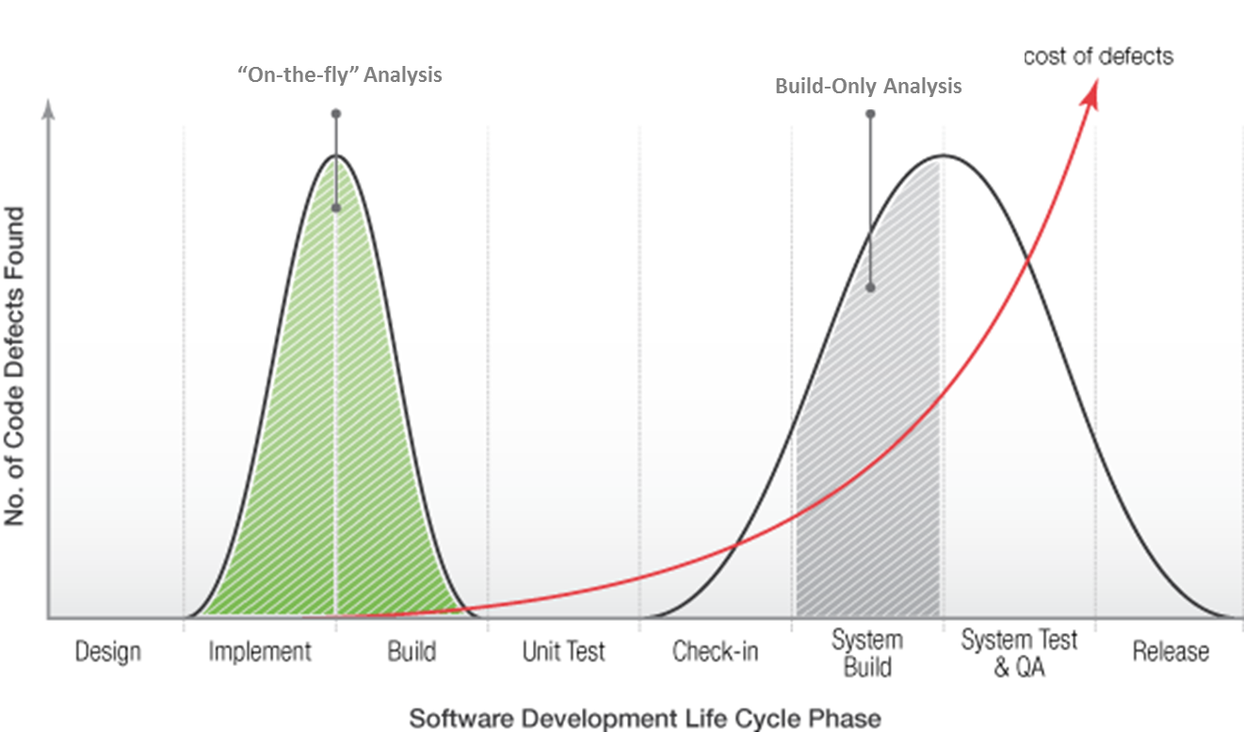
Anything else SCA can help with?
More advanced SCA also weed out bugs, early!
Finding bugs early means no time wasted with approvals, etc
Unit/integration testing then focussed on finding design issues

Slide 22
FDA modelling and coding guidelines
To support the correctness of the design and implementation, the design and coding guidelines for the modelling, or programming languages, shall address the topics listed below:
Topics ASIL
A B C D
1a Enforcement of low complexity ++ ++ ++ ++
1b Use of language subsets ++ ++ ++ ++
1c Enforcement of strong typing ++ ++ ++ ++
1d Use of defensive implementation techniques o + ++ ++
1e Use of established design principles + + + ++
1f Use of unambiguous graphical representation + ++ ++ ++
1g Use of style guides + ++ ++ ++
1h Use of naming conventions ++ ++ ++ ++
Notes:
Taken from ISO 26262-6 (2011) – Section 5.4.7
For 1a, an appropriate compromise of this topic with other methods in this part of ISO 26262 may be required.
The objectives of method 1b are
Exclusion of ambiguously defined language constructs which may be interpreted differently by different modellers, programmers, code generators or compilers.
Exclusion of language constructs which from experience easily lead to mistakes, for example assignments in conditions or identical naming of local and global variables.
Exclusion of language constructs which could result in unhandled run-time errors.
The objective of method 1c is to impose principles of strong typing where these are not inherent in the language.

Slide 23
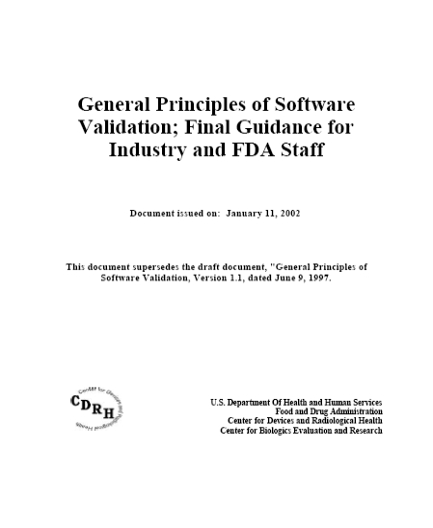
FDA Developer Testing Guidelines
U.S. FDA, China cFDA
General Principles of Software Validation;
Final Guidance for Industry and FDA Staff
Section 5.2.5
Testing by the Software Developer
Unit Testing
Integration Testing
System Testing

Slide 24
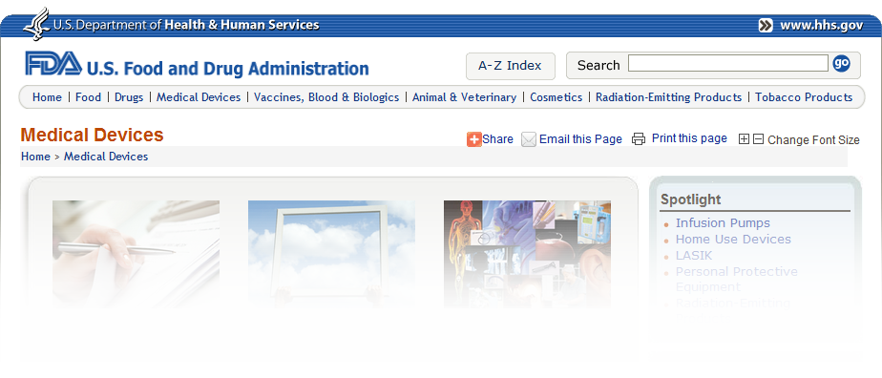
FDA Developer Testing Guidelines
“A software products testing can be organized into unit, integration, and system testing”
“Testing starts with unit test and concludes with system testing”
“Testing entails running software products under known conditions with defined inputs and documented outcomes”
“Essential element of test is the expected result”
“The amount of structural coverage is commensurate with the level of risk posed”
“Regression analysis and testing are employed to provide assurance that a change has not created a problem”

Slide 25
Medical Device Software Defects
“An FDA analysis of 3,140 medical device recalls conducted between 1992 and 1998 reveals that 79% of software-related recalls were caused by software defects introduced when changes were made to the software after its initial production and distribution.
The primary cause of these critical failures: repeatability. A software development process with a lack of repeatability is destined to failure.”

Slide 26
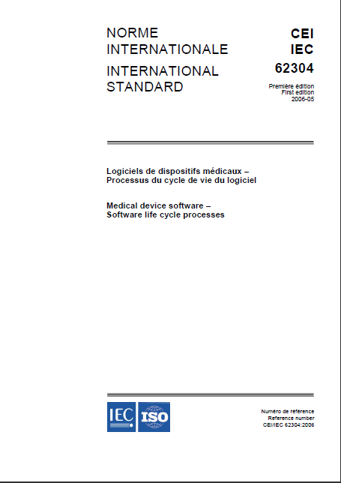
International Standard for Medical Device Software
IEC 62304
Medical Device Software –
Software Lifecycle Processes
First edition 2006-05
Section 5.5
Software Unit Implementation and Verification
Section 5.6
Software Integration and Integration Testing
Section 5.7
Software System Testing

Slide 27
IEC 62304 - Software Safety Classifications
“The MANUFACTURER shall assign to each SOFTWARE SYSTEM a software safety class (A, B, or C) according to the possible effects on the patient, operator, or other people resulting from a HAZARD to which the SOFTWARE SYSTEM can contribute.””
The software safety classes shall initially be assigned based on severity as follows:
Class A: No injury or damage to health is possible
Class B: Non-SERIOUS INJURY is possible
Class C: Death or SERIOUS INJURY is possible

Slide 28
IEC 62304 Safety Classification Effects
Software Documentation | Class A | Class B | Class C
Software development plan | Must contain contents to sections 5.1 IEC 62304:2006. The plan's content list increases as the class increases, but a plan is required for all classes.
Software requirements specification | Software requirements specification conforming to 5.2 IEC 62304:2006. The content list for the software requirements specification increases as the class increases, but a document is required for all classes.
Software architecture | Not required. | Software architecture to 5.3 IEC 62304:2006. Refined to software unit level for Class C.
Software detailed design | Not required. |  | Document detailed design for software units. (5.4).
Software unit implementation | All units are implemented, documented and source controlled (5.5.1).
Software unit verification | Not required. | Define process, tests and acceptance criteria (5.5.2, 5.5.3). Carry out verification (5.5.5) | Define additional tests and acceptance criteria (5.5.2, 5.5.3, 5.5.4). Carry out verification (5.5.5).
Software integration and integration testing | Not required. | Integration testing to 5.6 IEC 62304:2006.
Software system testing | Not required. | System testing to 5.7 IEC 62304:2006.
Software release | Document the version of the software product that is being released (5.8.4). | List of remaining software anomalies, annotated with an explanation of the impact on safety or effectiveness, including operator usage and human factors.
Summary of safety classification effects on the code development documentation and process

Slide 29
The Software Architecture Headache

Slide 30
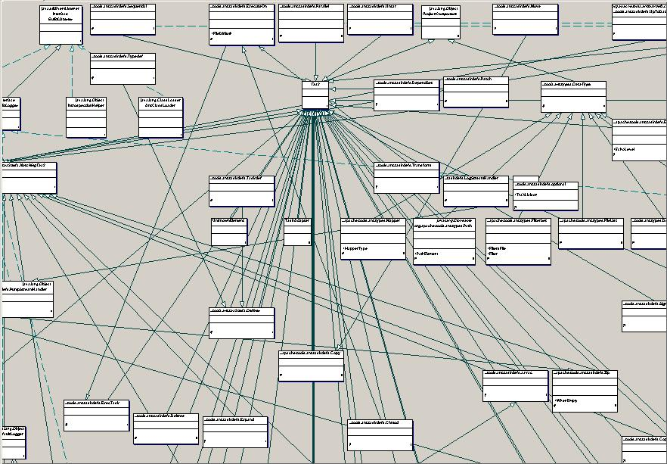
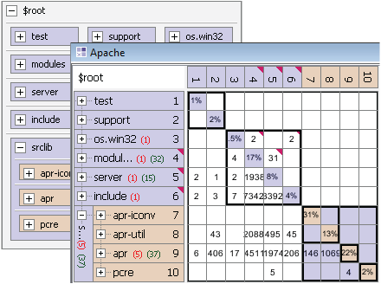
Architecture Blueprint
Hard to determine which dependencies are bad
Dependency Structure Matrix is the most scalable way to visualize dependencies & specify architecture

Slide 31
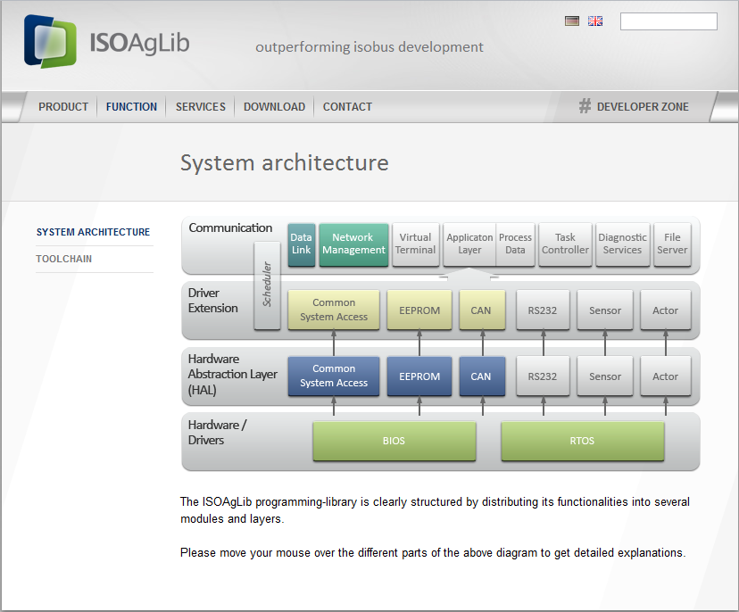
Example of Software Architecture
“clearly structured…into several modules and layers”

Slide 32
Software Architecture Erosion
Erosion results from dependencies which
violate the intended architecture,
crossing layer or component boundaries
These couplings prevent modularity
and lead to higher defect levels,
while also increasing the costs
to build, test, and maintain your system
“Spaghetti Code”
Notes:
32

Slide 33
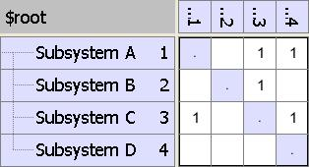
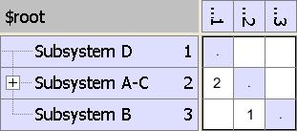
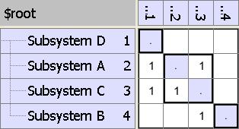
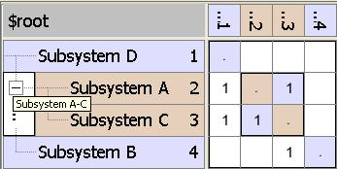
What’s a DSM?
  A Simple DSM
  Create Layers
  DSM Partitioning
  Hierarchical DSM

Slide 34
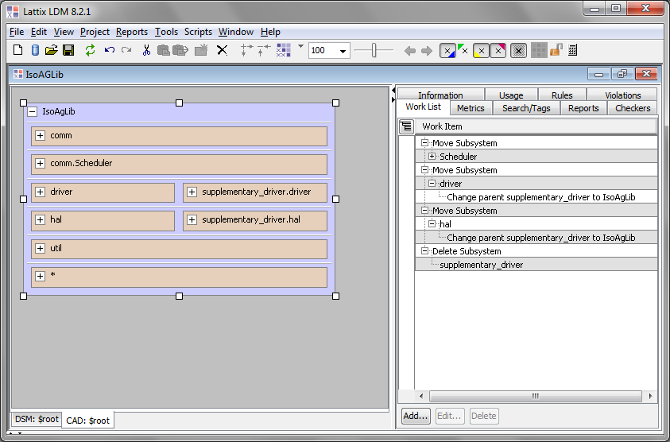
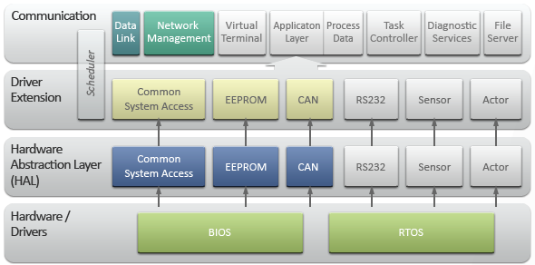
Transform DSM
Worklist tracks changes during transformation
Place the optional modules in the architecture

Slide 35
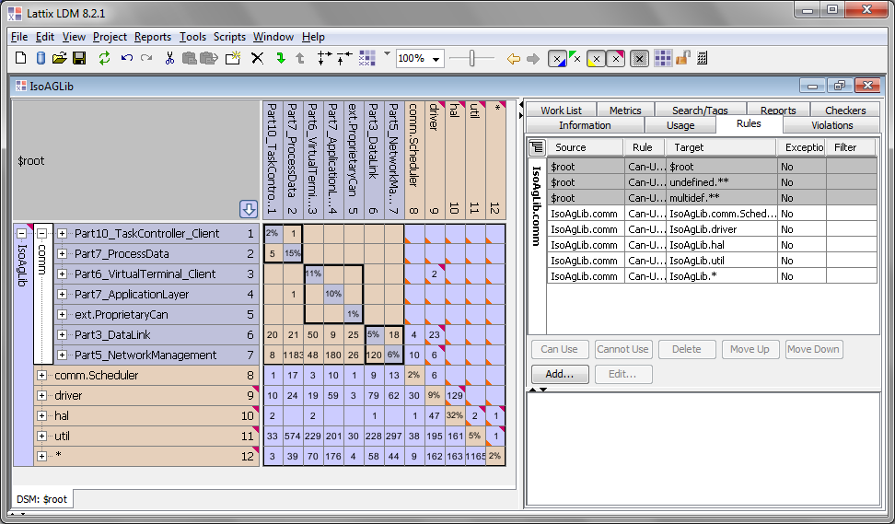
Establish Rules - Independence

Slide 36
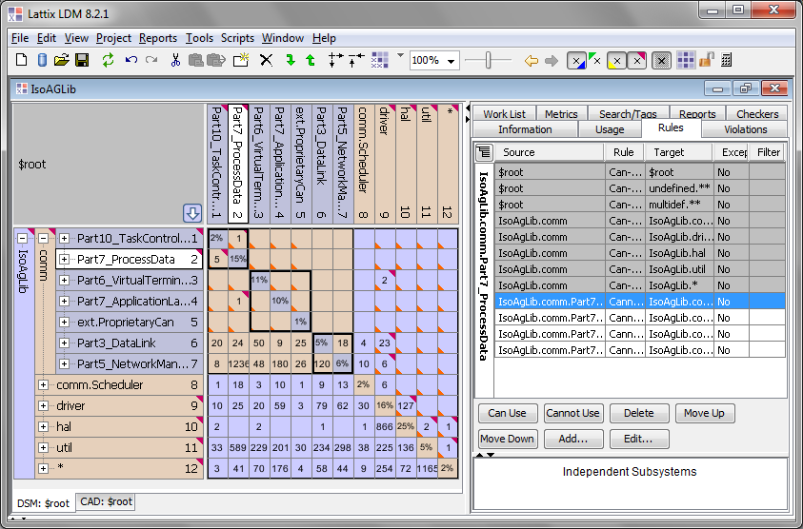
Establish Rules - Independence
Optional Modules are independent but can use mandatory Modules
Violations are identified at every level

Slide 37
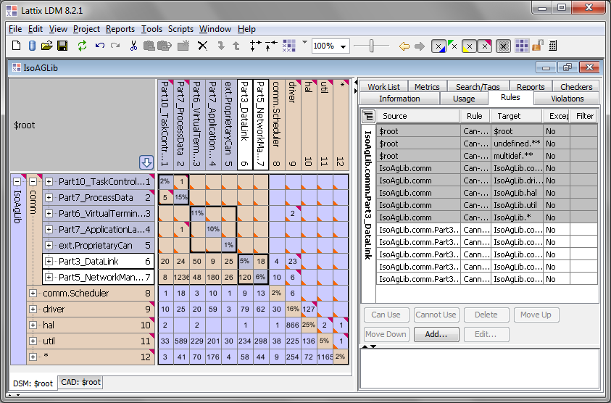
Establish Rules – Sublayering
Mandatory Modules should not use Optional Modules

Slide 38
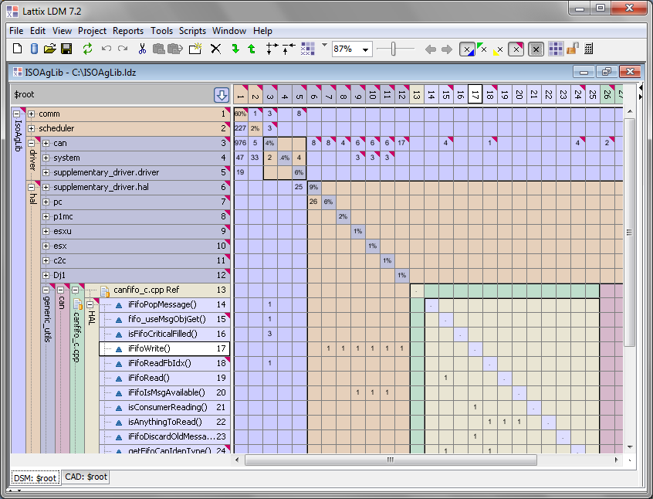
Establish Rules - API
API is visible, as are private members

Slide 39
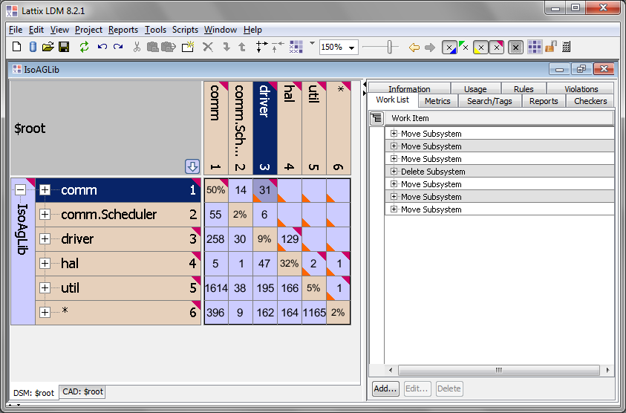
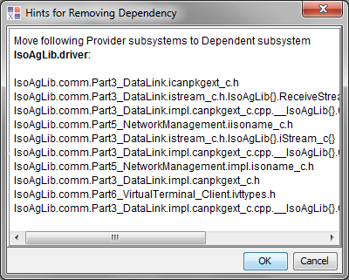
Fix Violations
Decouple driver from scheduler

Slide 40
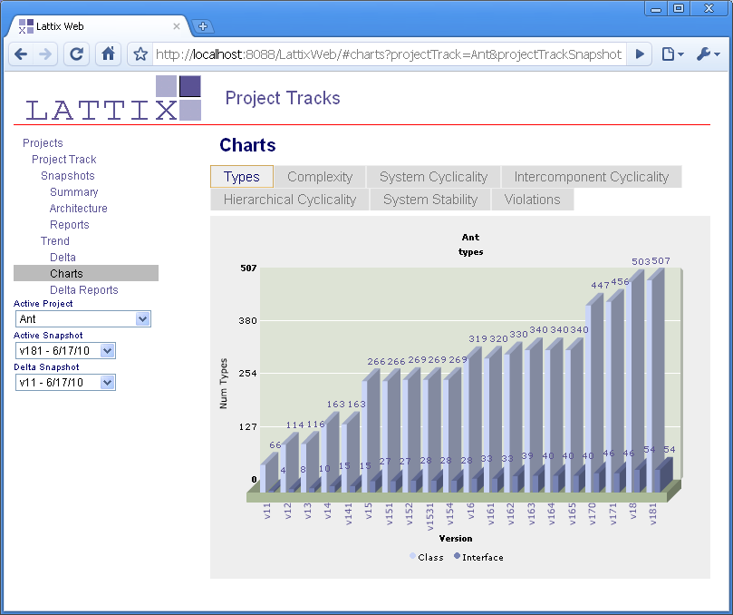
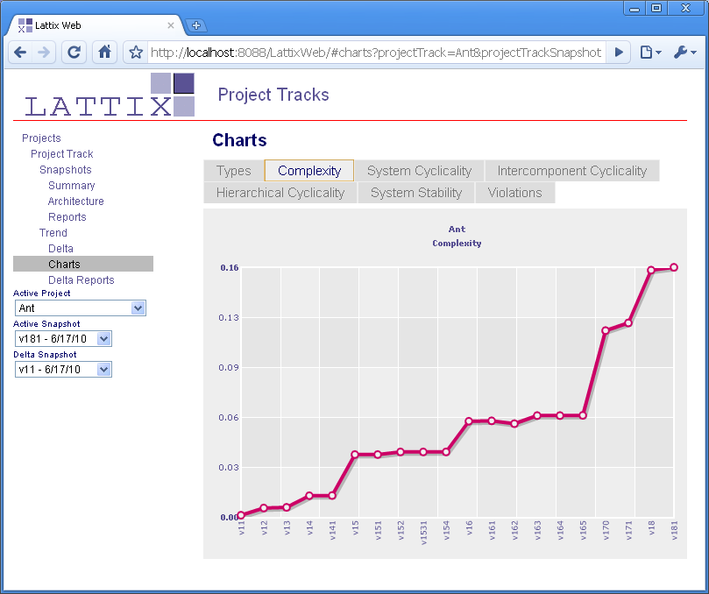
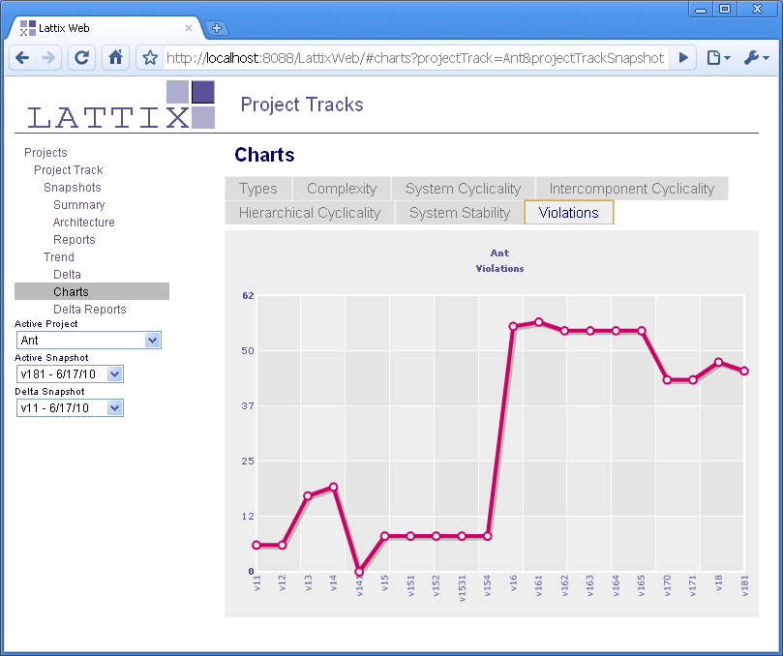
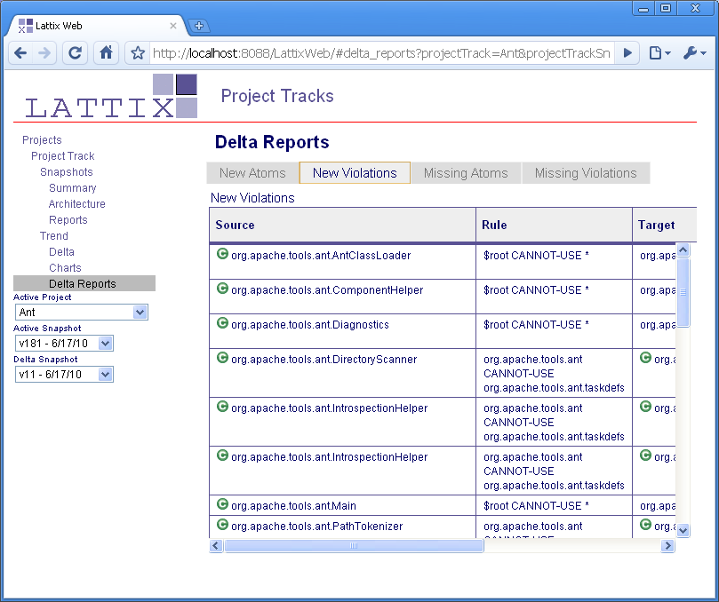
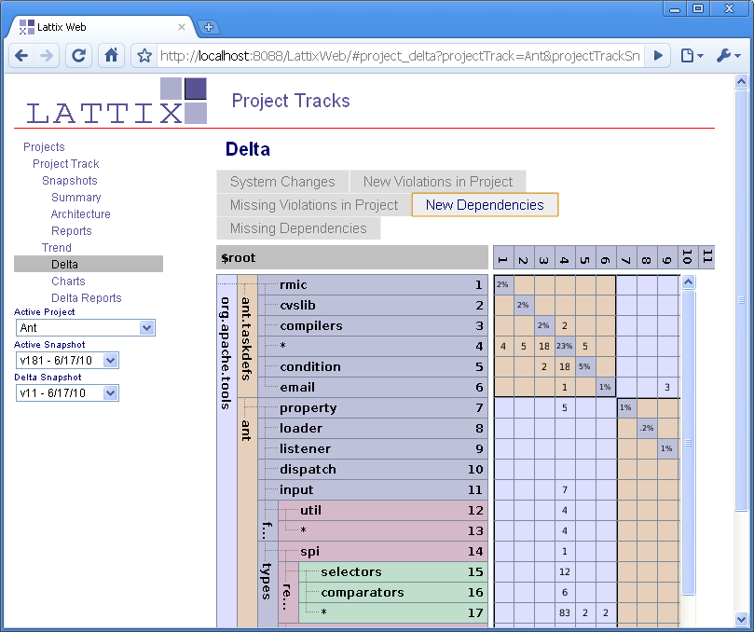
Measure, Report, Track, & Compare
Charts show comparisons of key metrics across a selected range of Snapshots
Charts show comparisons of key metrics across a selected range of Snapshots
Delta Reports compares the active Snapshot with any previous one to see changes in metrics and new/missing dependencies and violations
Delta Reports compares the active Snapshot with any previous one to see changes in metrics and new/missing dependencies and violations

Slide 41
The Software Security Headache

Slide 42
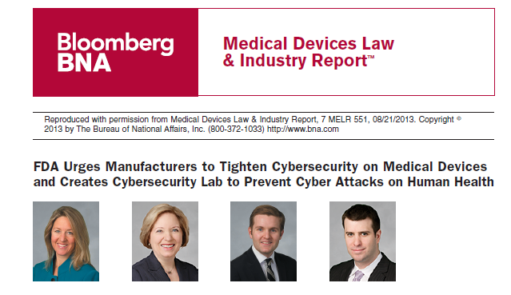
Software Security
  Growing Concerns about security in medical devices
  The FDA is developing a cybersecurity laboratory in which a fuzz testing capability is to be integrated

Slide 43
Software Security – our coverage
  OWASP Top 10 which was recently updated in June of 2013
    TTP supports seven (7) out of the 10. Of the remaining three, only one is statically verifiable.
    This is an improvement over the previous version of the standard.
  CWE/SANS Top 25 Most Dangerous Software Errors
    We support twelve (12) of the Top 25. This is excellent since a large majority of the standard is not statically verifiable
    Our nearest competitor only support eight (8).
    Major focus area for the next release.
  CWE – Common Weakness Enumeration
    Have excellent support for the entire list of CWE entries
  We also support
    CERT Secure Coding for C/C++ and Java
    The latest version of the DISA STIG “Application Security and Development” at Version 3, Release 5.

Slide 44
The Emenda Total Testing Platform

Slide 45
Emenda – Total Testing Platform
Licence conflicts
FOSS
e.g.src calls lib,
lib should not use src
Architecture
e.g. deadlocks, mutex,
Threads, semaphores,
Sleep issues
Security
Buffer overruns,
Denial of service
SQL injections
Threads/Deadlocks
e.g. pointer dereference
p->q;
where p = NULL
e.g. class interfaces,
Function call chains
e.g. class interfaces,
Function call chains
Interprocedural
Crash Causing
e.g. uninitialised
Variables
Logic Flow
e.g.
if (a = b) {
if (a != b) { }
}
Control Flow
e.g. if (a = b)
Syntactically ok, but
Meaning is not correct
Semantic
Detected by most
Compilers and simple
Analysis, code
Walthroughs, etc
Syntactic

Slide 46
Emenda – Total Testing Platform
DASHBOARD
Project Comparator, KPIs, Metrics, Architectural Dependency Structure
Project Health Scores, Drill-down to issues
System level tests,
Simulating DoS
Attacks, robustness
testing
Understand your
Code base through
Flowcharts, graphing
e.g. class interfaces,
Function call chains
Visualisation
Fuzzing
Management of
Open source components
FOSS
Partitioning Algorithms
Discovery
Cluster Analysis
Rules
Architecture
Unit Testing
Integration Testing
Code Coverage
Embedded Systems
Dynamic Testing
Defects
Security
Developer & System level
Static Analysis

Slide 47



Emenda – Total Testing Platform
Static Analysis Testing
Klocwork for C, C++, Java, C#. Advanced Defect detection for improved security, reliability and maintainability.
Understand – Visualisation of your source code, flow charts, heat maps, metrics…
Dynamic Testing
VectorCast for C, C++ and Ada.
  Unit / Integration Dynamic Testing
  System Test / Code coverage
  Regression Test Management
  Requirements Traceability
  Target Test Execution
Architecture
Lattix
  Solution to improve and enforce the architecture of the application via DSM

Slide 48




Emenda – Software Testing Platform
Open Source Management
Black Duck Software
  Licensing and compliance with the use of Open Source code
  Security challenges associated with Open Source Software (OSS)
Software Quality Management
SQUORE KPI dashboard
  Valuing software capital
  Visualizing Technical-Debt
  Monitoring software quality and security
CI / Release Management
Hudson / Jenkins
  Compilation, analysis, test… fully automated
  Klocwork, Understand, VectorCast plugins
ElectricCloud EAccelerator and ECommader
  Reduce your build times by as much as 20x
  Ensure you release what you should release

Slide 49
Our Solution- Total Testing Platform
Full Embedded Software Testing
    Unit and Integration testing
    Code coverage analysis through lifecycle
    Automated regression testing
    Testing on embedded targets and simulators
    Qualification materials for FAA, FDA, and others
True Embedded Test Automation
    “Easiest to Use” test tool on the market
    Easy continuous integration and test for repeatability
    Integration with best of breed static analysis tools
Total Testing
World-Class Service and Support
    Our engineers are our support staff
    Local support via phone and email
    Consulting and Technical Training
semi-automated tools
Benefits of using Emenda TTP
free and other manual tools
    Reduced Time-To-Market
    Easier Certification / Qualification
    Verifiable savings of time and money
no
automation

Slide 50
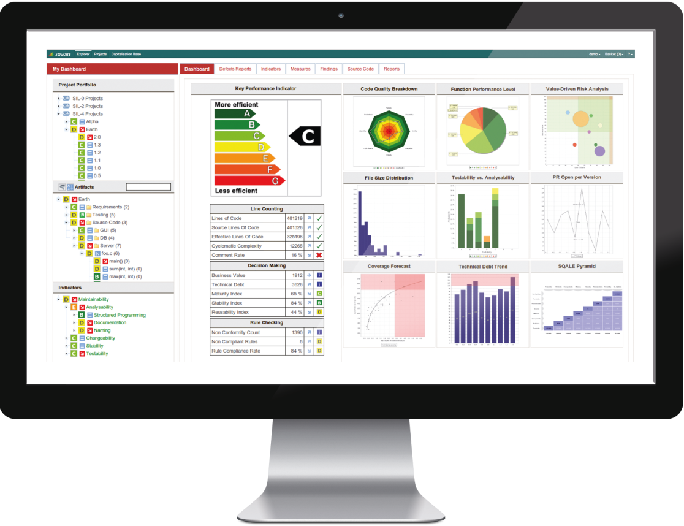
Dashboarding
Code analyzers and other tools
Business Intelligence
Capitalization
Dashboard
Notes:
Business Intelligence :
Business intelligence (BI for Business Intelligence in English) refers to the means, the tools and methods to collect, consolidate, model and render a company's data to provide decision support and enable a decision maker to have an overall view of activity treated.
In the first sense, the BI tools and techniques associated with the interpretation of financial or business data organizations
Strategic innovation SQuORING is to position the dashboard SQuORE as a next generation tool that uses the methods of business intelligence to optimize the control of software projects.
SQuORE and is the first tool that will put in the service of control of software projects, the four basic functions of a decision support system:
1) Collection
SQuORE collection and aggregates to complex measurements from various sources of data on software project code analyzers, environments, configuration management and change, test tools, etc. ...
2) Integration
Harmonized and synchronized data are integrated into the database SQuORE
3) Diffusion
- Selection of key performance indicators (KPI) are the data analysis and decision-making models
- Automatic generation of action plans
- Demonstration of cause and effect based capitalization, trend analysis
5) Presentation
- Presentation of indicators in an accessible, relevant and intelligible through a dashboard-based intuitive graphical
- Adaptation of the dashboard to the profile of each user
An adaptable secure web interface, and collaborative

Slide 51
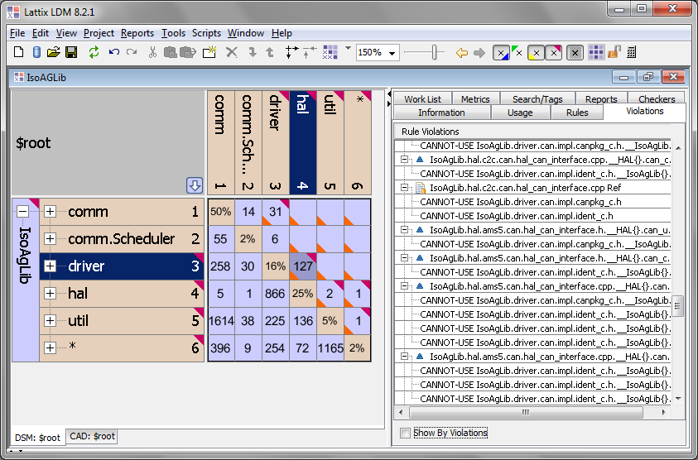
Architectural analysis

Slide 52
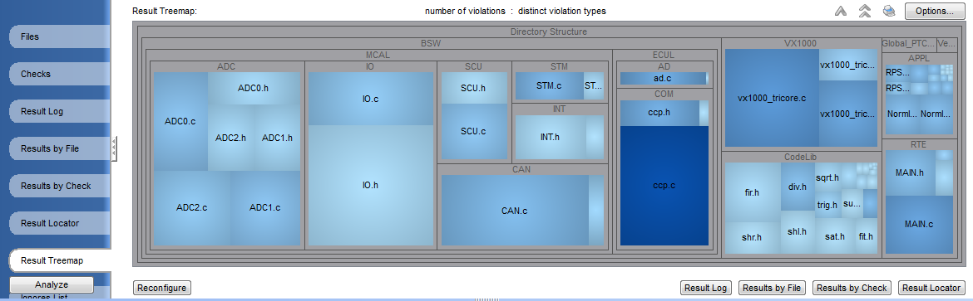
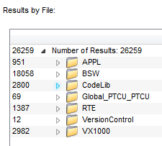
Defect density
Heatmap showing areas of greatest
concern
Notes:
We also offer an “intellectual property audit” service where we take your project, scan it on our server, carry out all of the matching work and present you with an audit report at the end of the process for you to take away. This can be a one off engagement or we can offer this as a regular service (e.g. once a year). An audit does however require us to have access to the source code.
**From Website**
Using the Black Duck® Suite, Emenda offers comprehensive Software Intellectual Property Audits as a professional service. This auditing process provides a fast, convenient, and accurate way of identifying the components that make up a given code base and reporting any open source, third party code, and related software licensing obligations. The audit is conducted confidentially and securely by a trained Emenda consultant and consists of:
A comprehensive scan of the code base under audit using Black Duck® Protex™
A full inventory of the components that make up the code base under audit
A report identifying open source and third-party licences that are relevant to that code base
An advisory session to walk through the results of the report and discuss any issues that arise
This service can also be used as part of the due dilligence process in acquisitions and by companies to obtain a snapshot of their software prior to release into the market, or more generally, to identify existing licensing obligations and increase confidence in the code base.

Slide 53
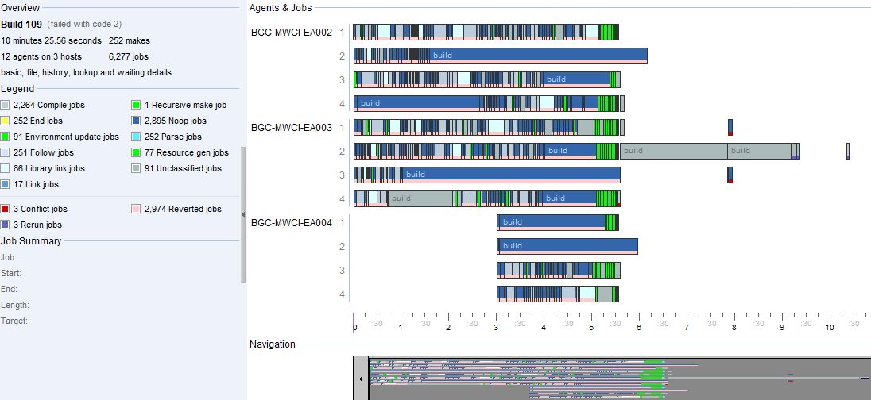
Build analysis & acceleration

Slide 54
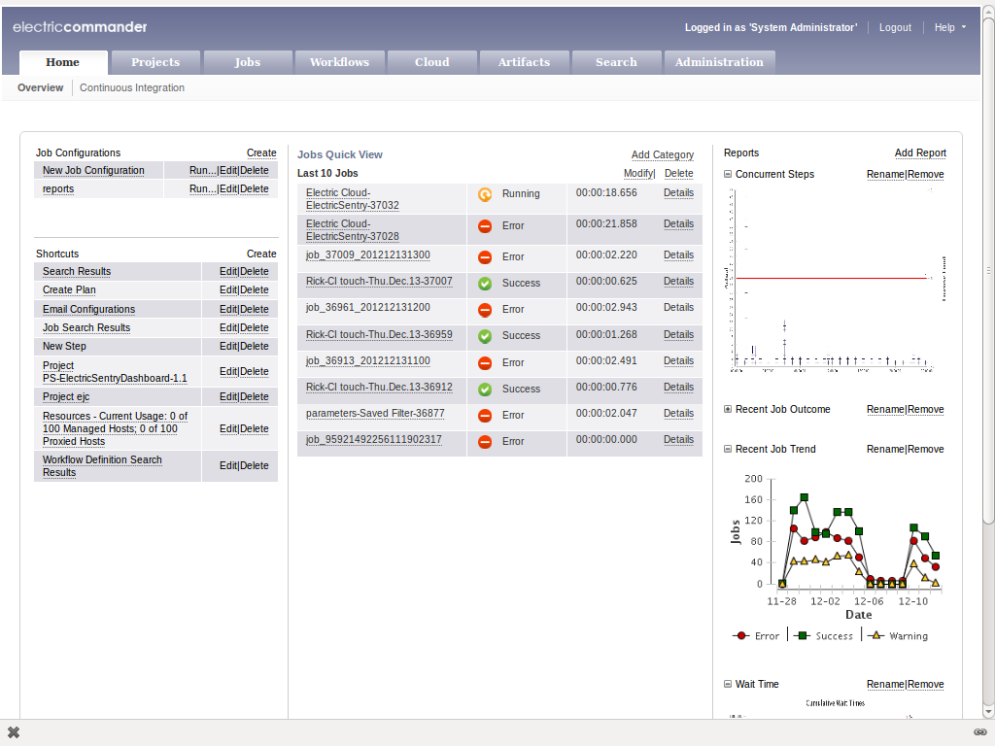
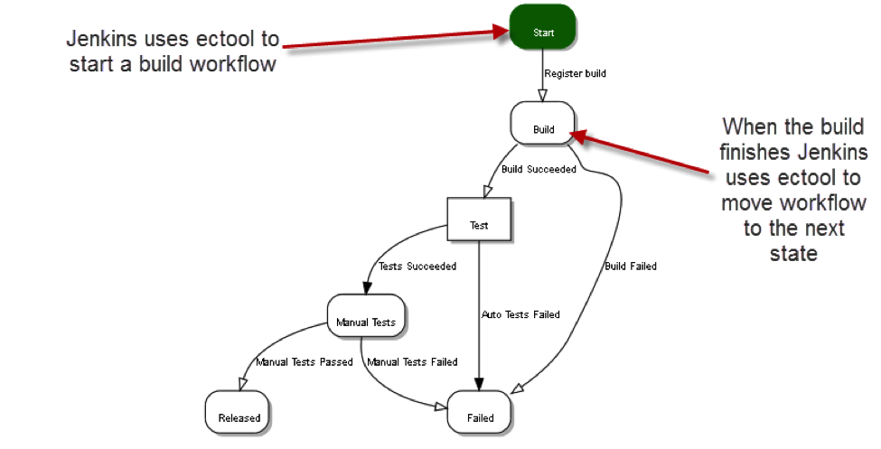
Release management automation

Slide 55
Characteristics of an Ideal Dynamic Analysis System
Fully automates harness generation to support low-level module testing
Supports and fully automates integration with a wide array of embedded targets
Allows stand-alone code coverage to support testing legacy code
Integrates with your existing requirements-tracking tool to support requirements traceability

Slide 56
Regression Testing leads to Better Quality!
“79% of all software errors in medical devices arise from the addition of new functionality and regression testing issues.”
-- FDA
An ideal platform should…
Provide a full command line interface to support test repeatability and integration with existing testing infrastructure
  Encourages continuous integration and test repeatability

Slide 57
Customer Success Stories

Slide 58
Customer Characteristics
95%
  95% of our customers are using VectorCAST to test embedded applications
50%
50% of our customers use live hardware and the rest use a target simulator
70%
  70% of our new customers are using C++ and the rest are using C; with many long-time customers still developing or maintaining systems in Ada
All of our customers want to be able to automate regression testing – not all of them are there yet

Slide 59

Emenda – Professional Services for medical projects
Software Verification and Validation
Functional safety standards processes and compliance
Implementation of unit and integration testing strategy and techniques
Static code analysis, code review, inspections and defect triaging
Coding standards/conventions enforcement
Custom metrics and management reporting
Automation of regression test suite
Software licensing and IP audits
Software design and architectural review

Slide 60

Emenda – Code Clinic
Code Clinic workshops provided by Emenda
Gives immediate, take-home information on the quality, security, maintainability and/or legal implications of the code
Emenda Total Testing Platform

Slide 61


Boston Scientific Corporation
Boston Scientific Corporation
Developer of the COGNIS® Cardiac Resynchronization Therapy Defibrillator
Use Emenda TTP with MC/DC for the most safety critical aspects of their application.

Slide 62
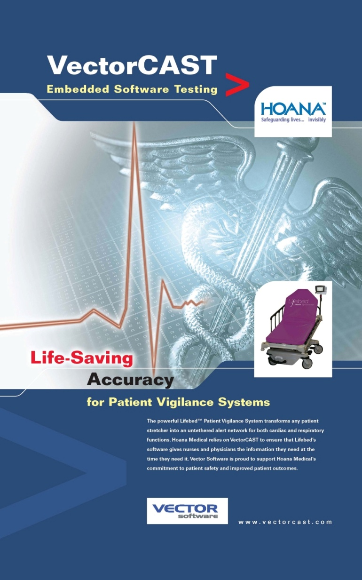

Hoana Medical, Inc.
Hoana Medical, Inc.
Developer of the Lifebed™ Patient Vigilance System
Use VectorCAST applications to test and certify the software embedded on its first FDA cleared product.

Slide 63
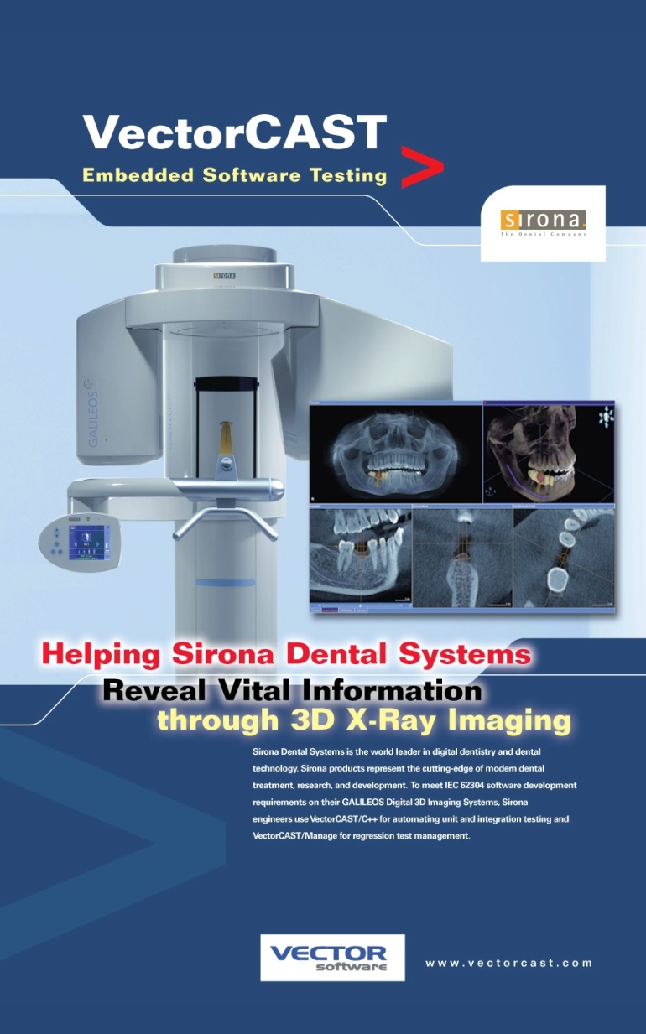

Sirona Dental Systems
Sirona Dental Systems
Developer of the GALILEOS 3D Digital Imaging Systems
Use VectorCAST/C++ and Manage
As part of their IEC 62304 development process .

Slide 64


Terumo Heart, Inc.
Terumo Heart, Inc.
Developer of the DuraHeart™
Left Ventricular Assist System (LVAS)
Use VectorCAST applications to test and certify embedded software running on their patented left ventricle assist implantable device.

Slide 65
Medical Customer Characteristics
95%
  95% of our customers are using Emenda TTP to test embedded applications
50%
50% of our customers use live hardware and the rest use a target simulator
70%
  70% of our new customers are using C++ and the rest are using C; with many long-time customers still developing or maintaining systems in Ada
All of our customers want to be able to automate regression testing – not all of them are there yet

Slide 66









Connect With Us
Emenda Software Website
Emenda.eu
Automated Software Testing Blog
vectorcast.com/blog
User Driven Community
testresponsibly.com
Emenda Professional Network
linkedin.com
Emenda Fans
facebook.com/emenda
www.emenda.eu
www.aligned.ch
News and Events
twitter.com/emenda
Tutorials and Demonstrations
youtube.com/emenda

Slide 67
The End – Any Questions?

